Slide 1
Analysis of BW system temperature spikes
2021-09-13

Slide 2
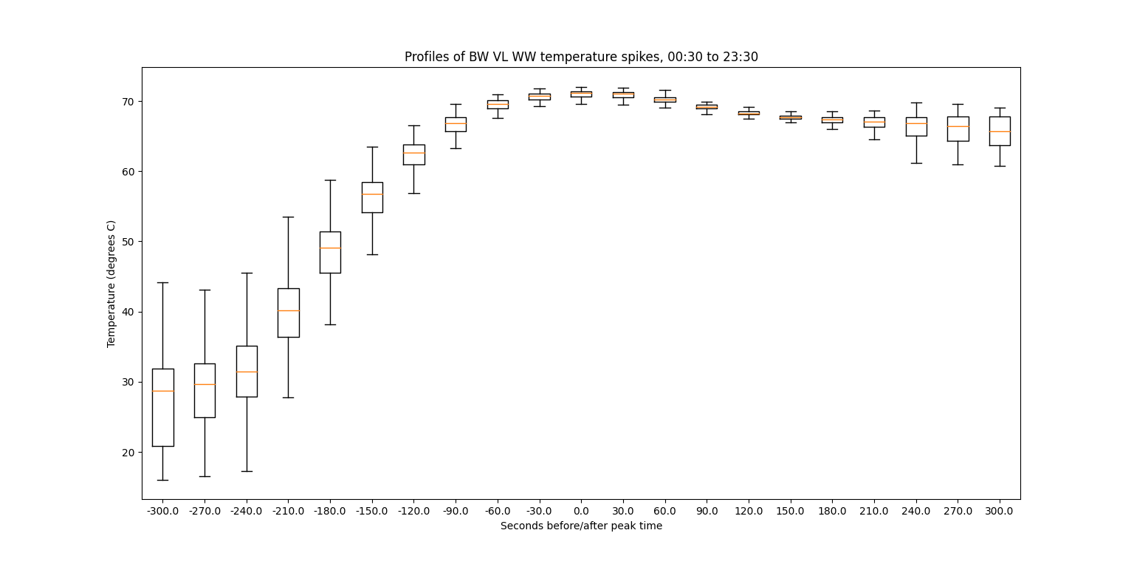
BW VL WW

Slide 3
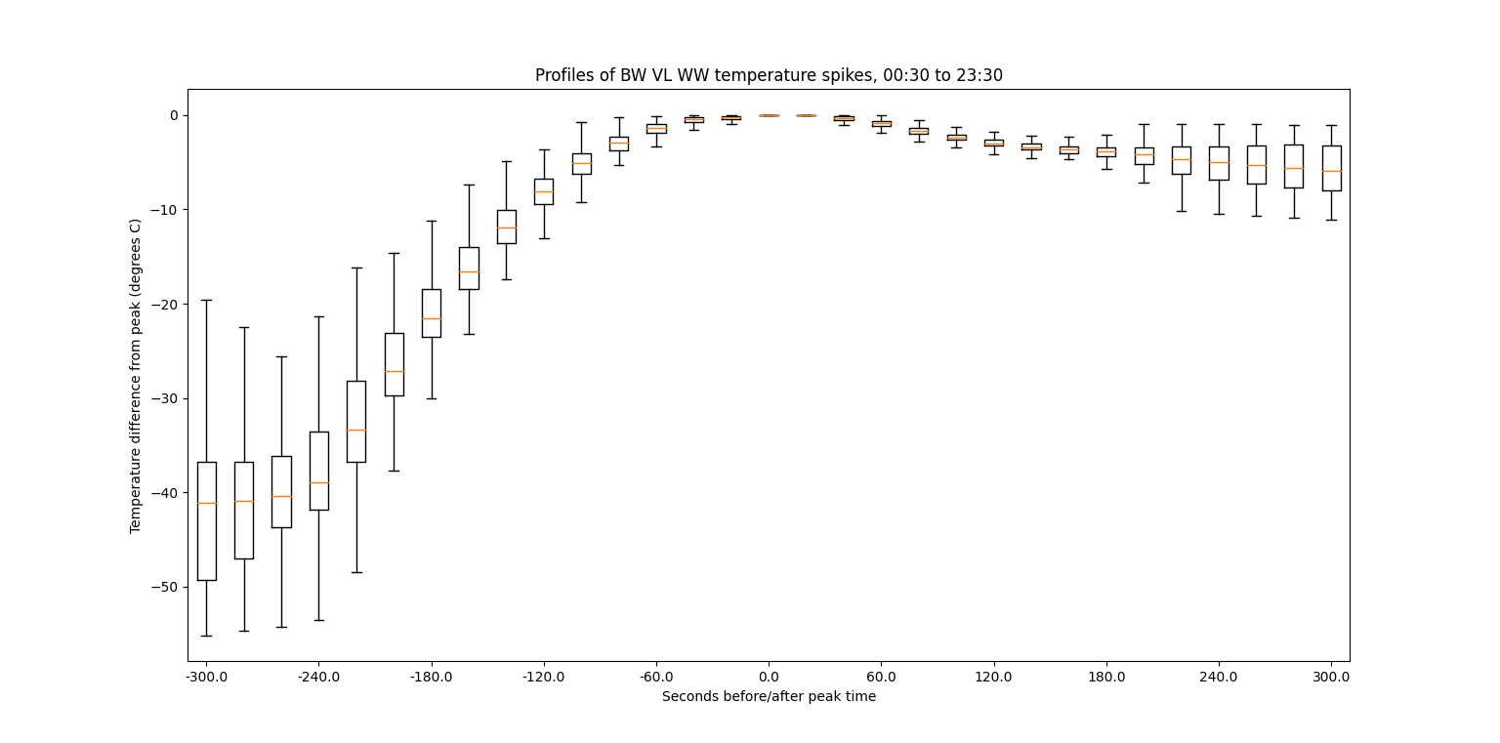
BW VL WW, temp diff from max

Slide 4
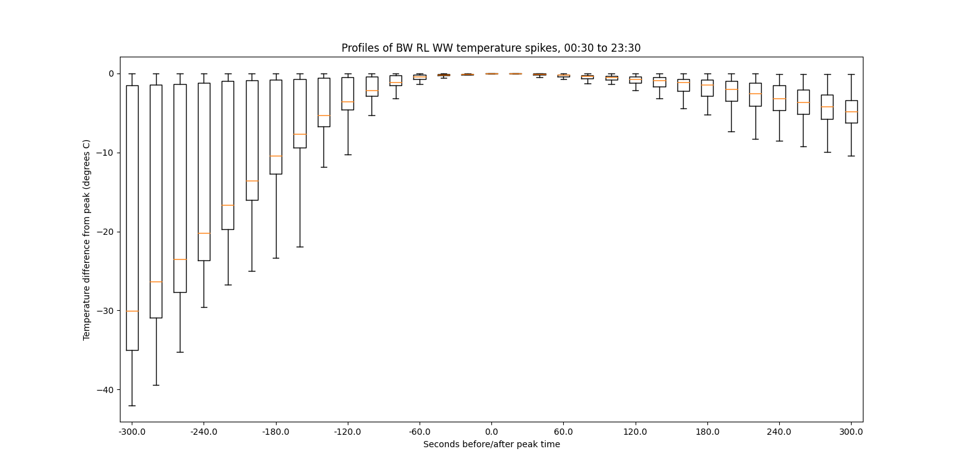
BW RL WW – at least 30 C max, 0.1 C diff

Slide 5
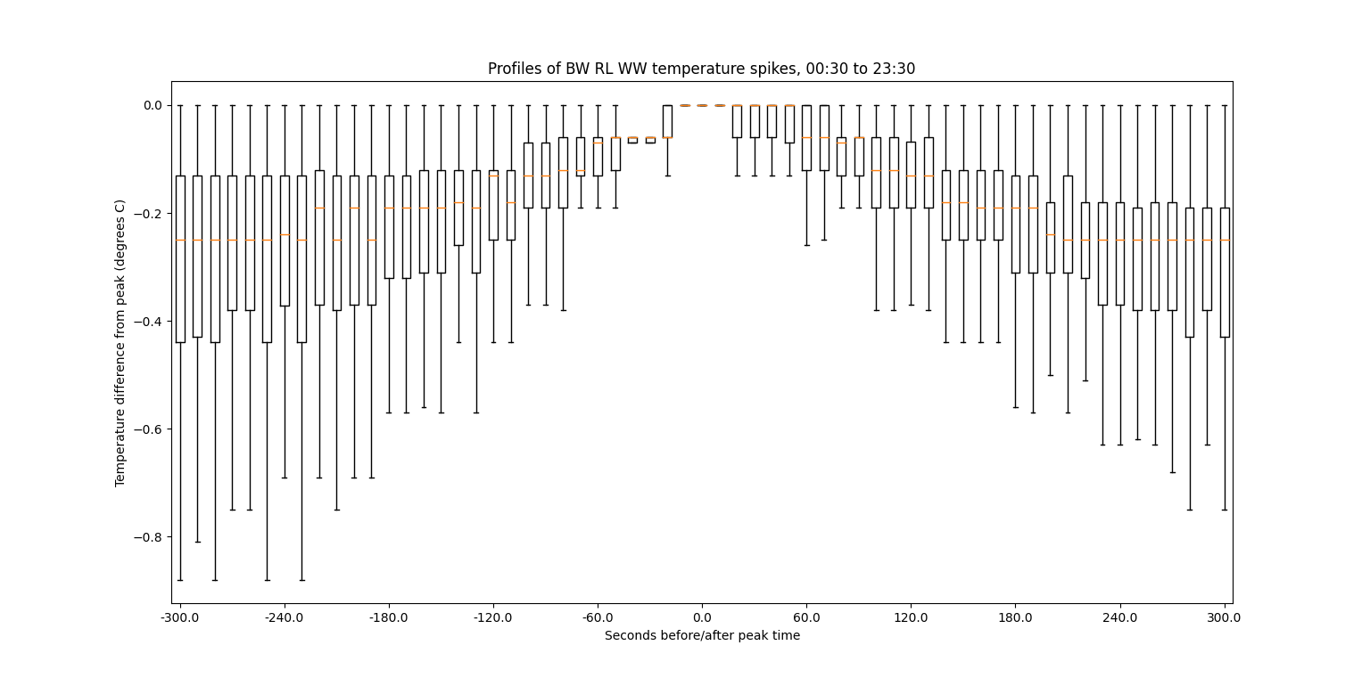
BW RL WW – low threshold max temp

Slide 6
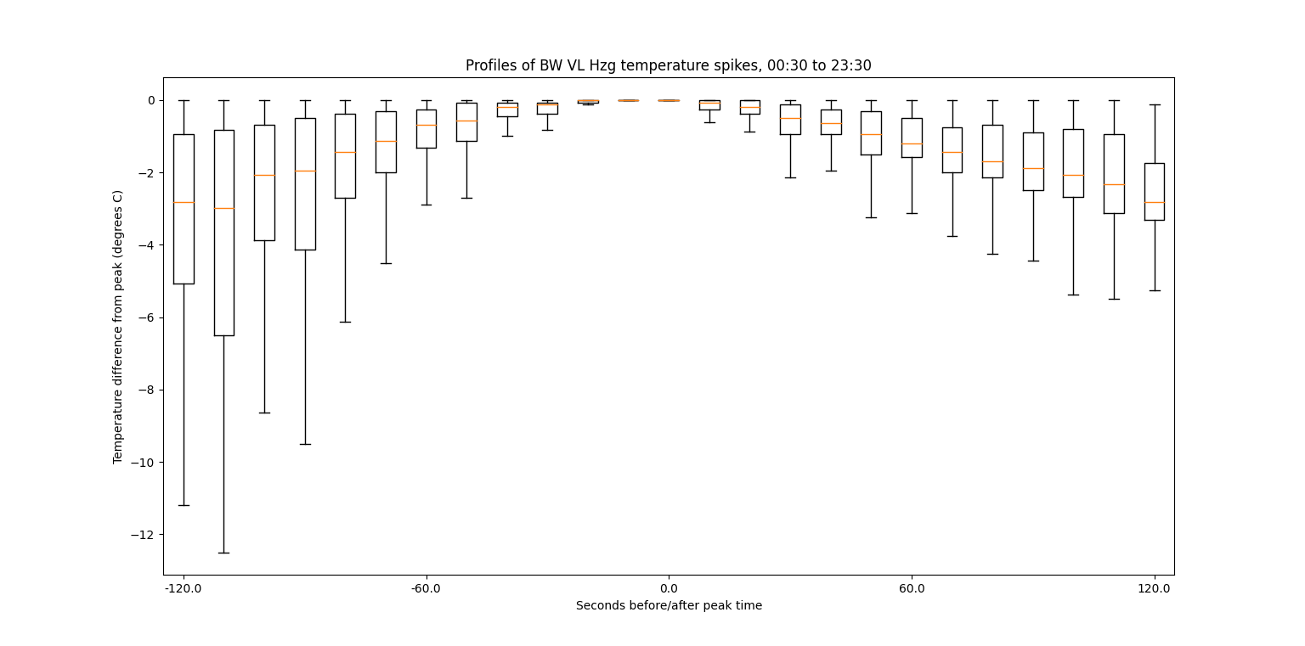
BW VL Hzg

Slide 7
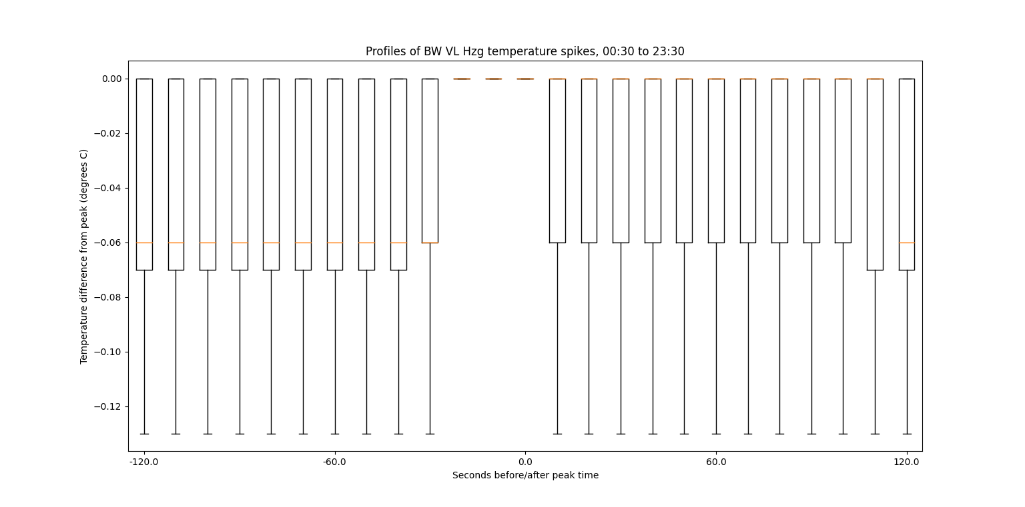
BW VL Hzg, no threshold temp diff

Slide 8
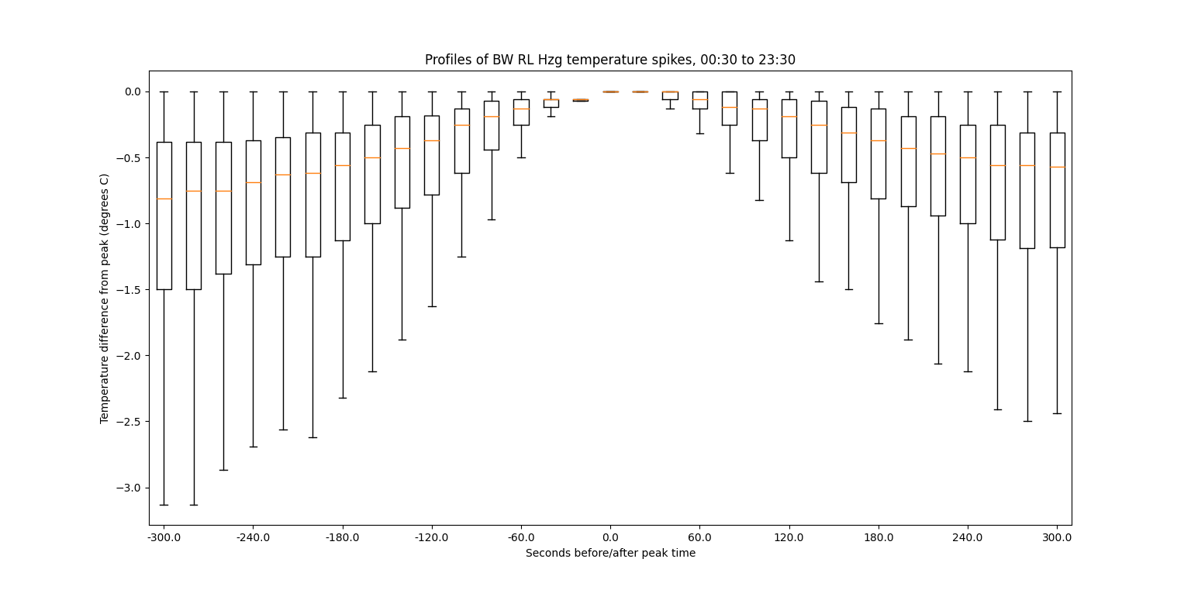
BW RL Hzg

Slide 9
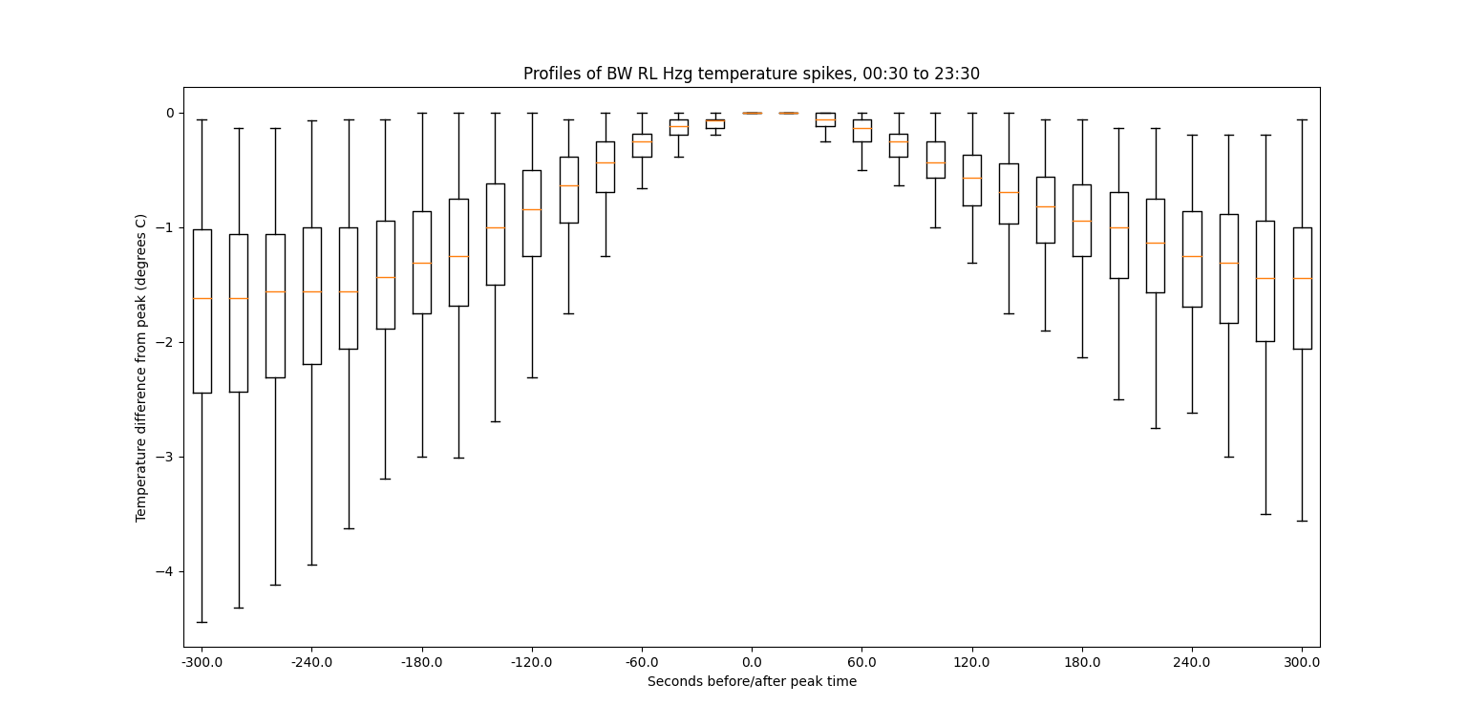
BW RL Hzg – 30 C threshold

